Slide 1
GATLING GUN
Made by Alexei Stoletov

Slide 2
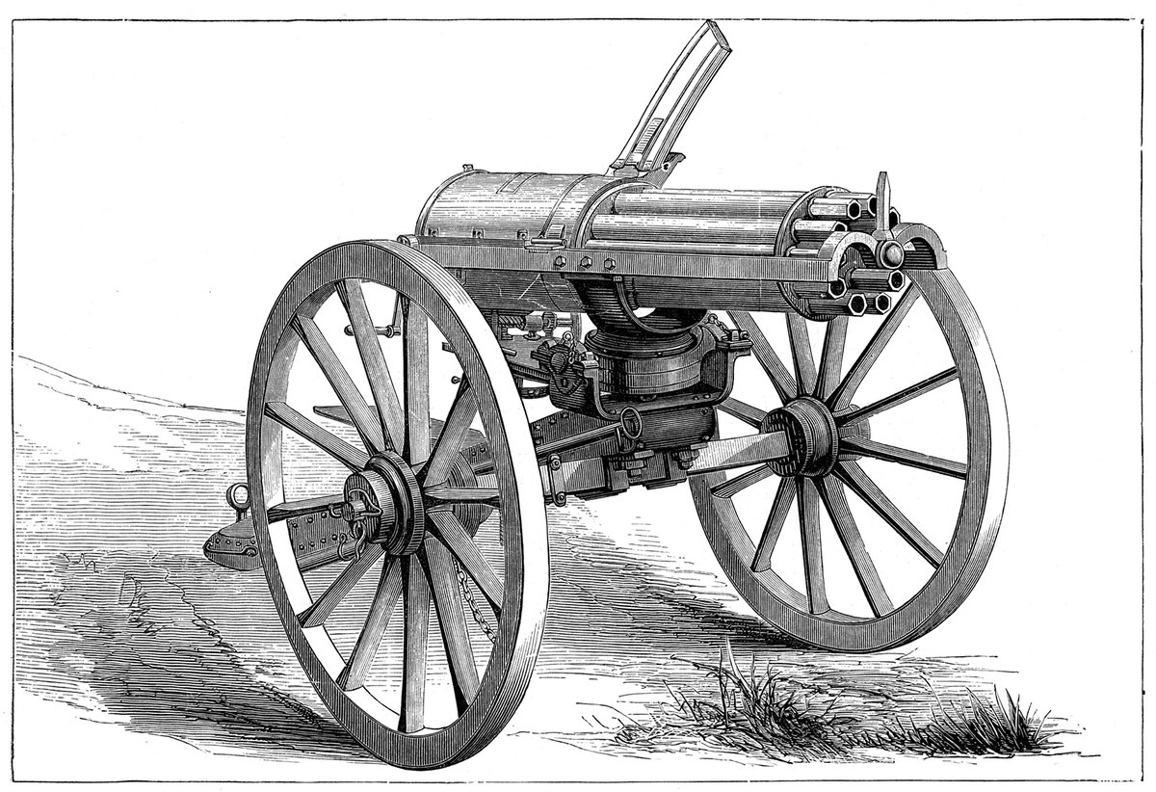
THE GATLING GUN
The Gatling gun is a rapid-firing multiple-barrel firearm invented in 1861 by Richard Jordan Gatling. It is an early machine gun and a forerunner of the modern electric motor-driven rotary cannon.

Slide 3
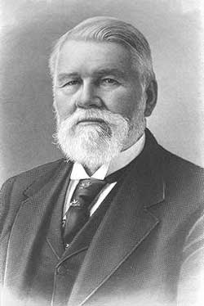
CREATOR OF GATLING GUN
Richard Jordan Gatling (1818 – 1903) was an American inventor. Besides Gatling gun his inventions include a screw propeller and a wheat drill (a planting device), a hemp break machine, a steam plow (steam tractor), a marine steam ram, and a motor-driven plow (tractor).

Slide 4
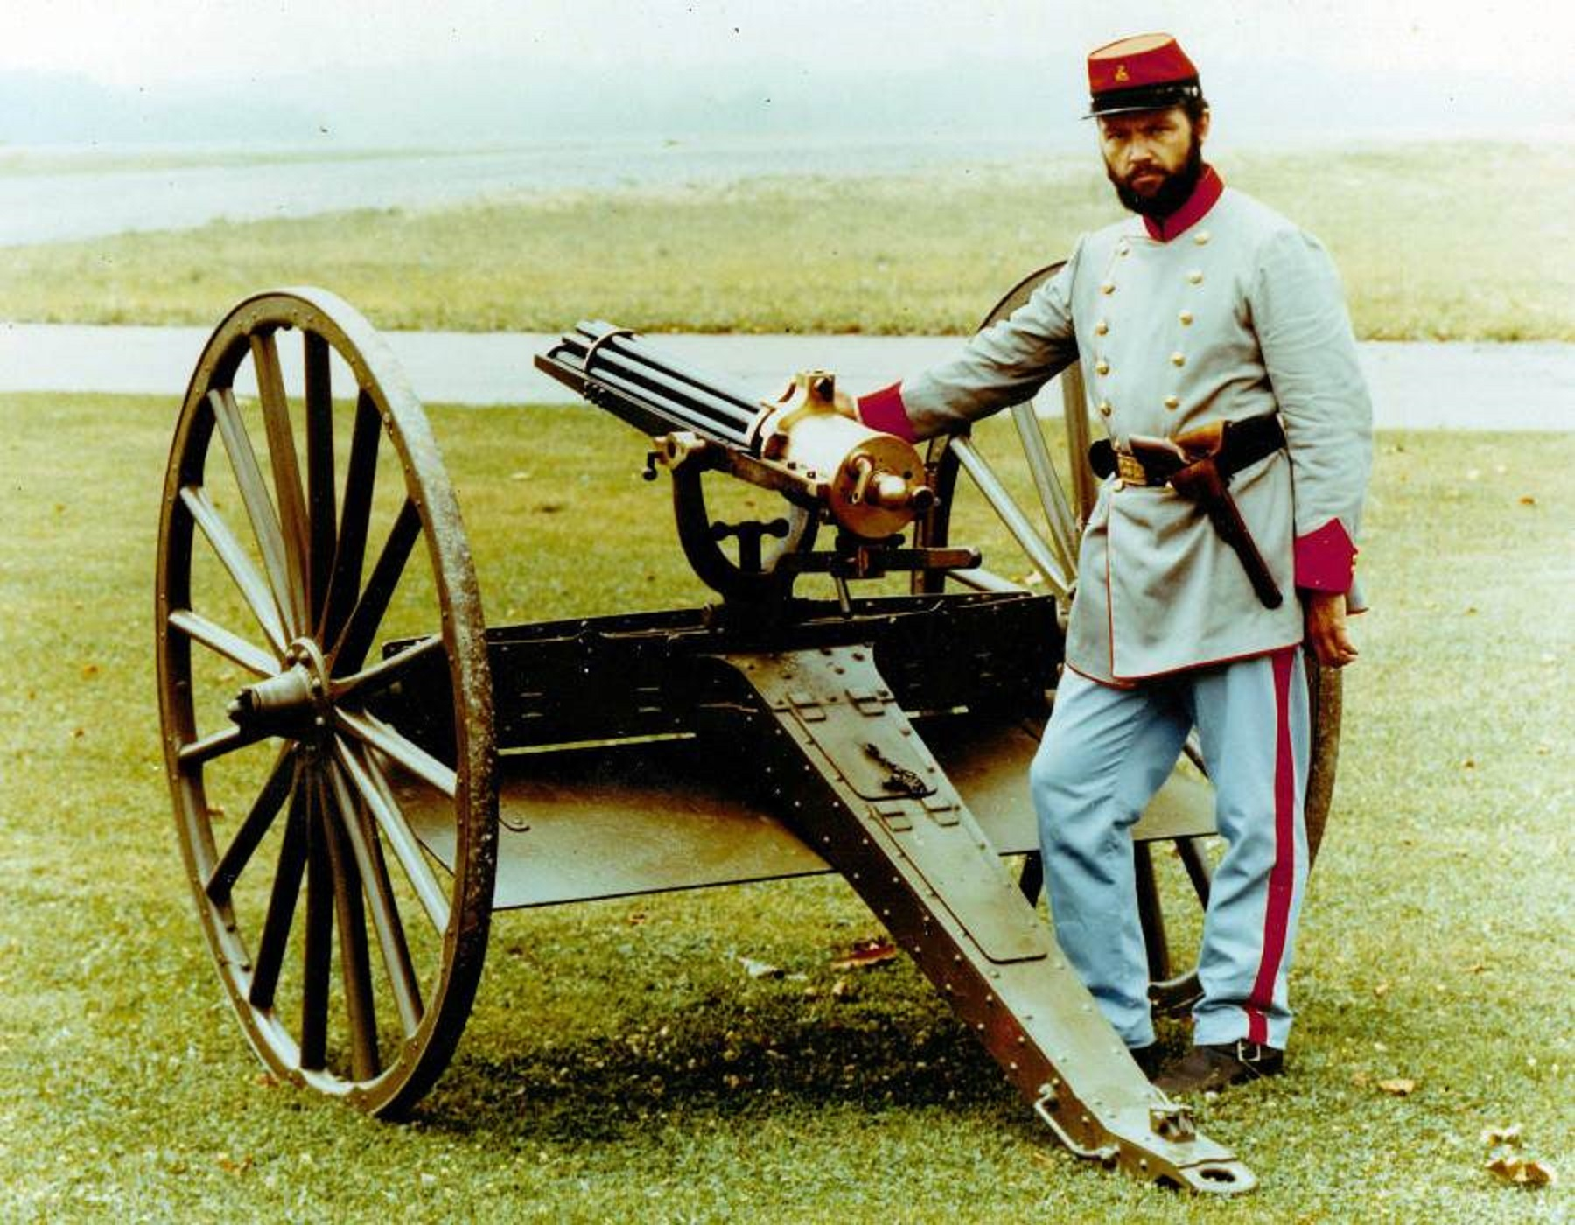
NOBLE CAUSE
Gatling invented the Gatling gun after he noticed that a majority of the soldiers fighting in the Civil War were lost to disease rather than gunshots. In 1877, he wrote, "It occurred to me that if I could invent a machine gun which could by its rapidity of fire, enable one man to do as much battle duty as a hundred, that it would, to a large extent supersede the necessity of large armies, and consequently, exposure to battle and disease would be greatly diminished."

Slide 5
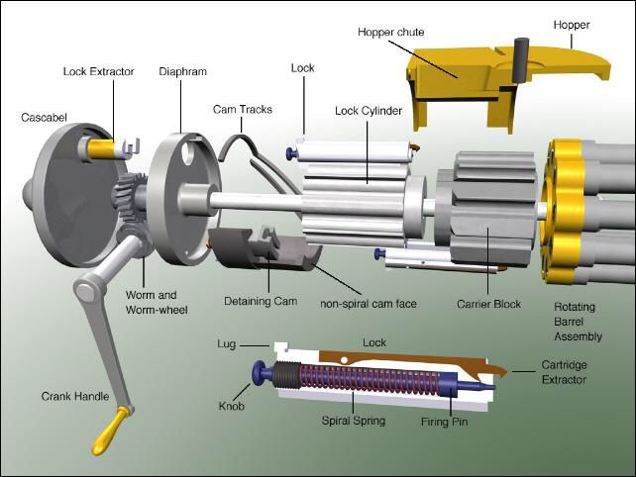
DESIGN OF WEAPON
The Gatling gun is operated by a hand-crank mechanism, with six barrels revolving around a central shaft (although some models had as many as ten). Each barrel fires once per revolution at about the same position. The barrels, a carrier, and a lock cylinder were separate and all mounted on a solid plate revolving around a central shaft, mounted on an oblong fixed frame. Turning the crank rotated the shaft. The carrier was grooved and the lock cylinder was drilled with holes corresponding to the barrels.

Slide 6
THANK YOU FOR YOUR ATTENTION
made by Alexei Stoletov

